Slide 1
Orleans Parish Juvenile Court
January 24, 2022

Slide 2
Although Intake assessments are compared to petitioned cases, the District Attorney’s Office still has 2 years on misdemeanor charges and 4 years on felony charges to file a petition.

Slide 3
Orleans Parish Juvenile Court provides intake services and assessments for youth arrested by New Orleans Police Department in Orleans Parish.
722 Juvenile Intake Assessments were completed January 1, 2020 - December 31, 2020

Slide 4
Orleans Parish Juvenile Court provides intake services and assessments for youth arrested by New Orleans Police Department in Orleans Parish.
568 juvenile Intake Assessments were completed January 1, 2021 - November 22, 2021

Slide 5
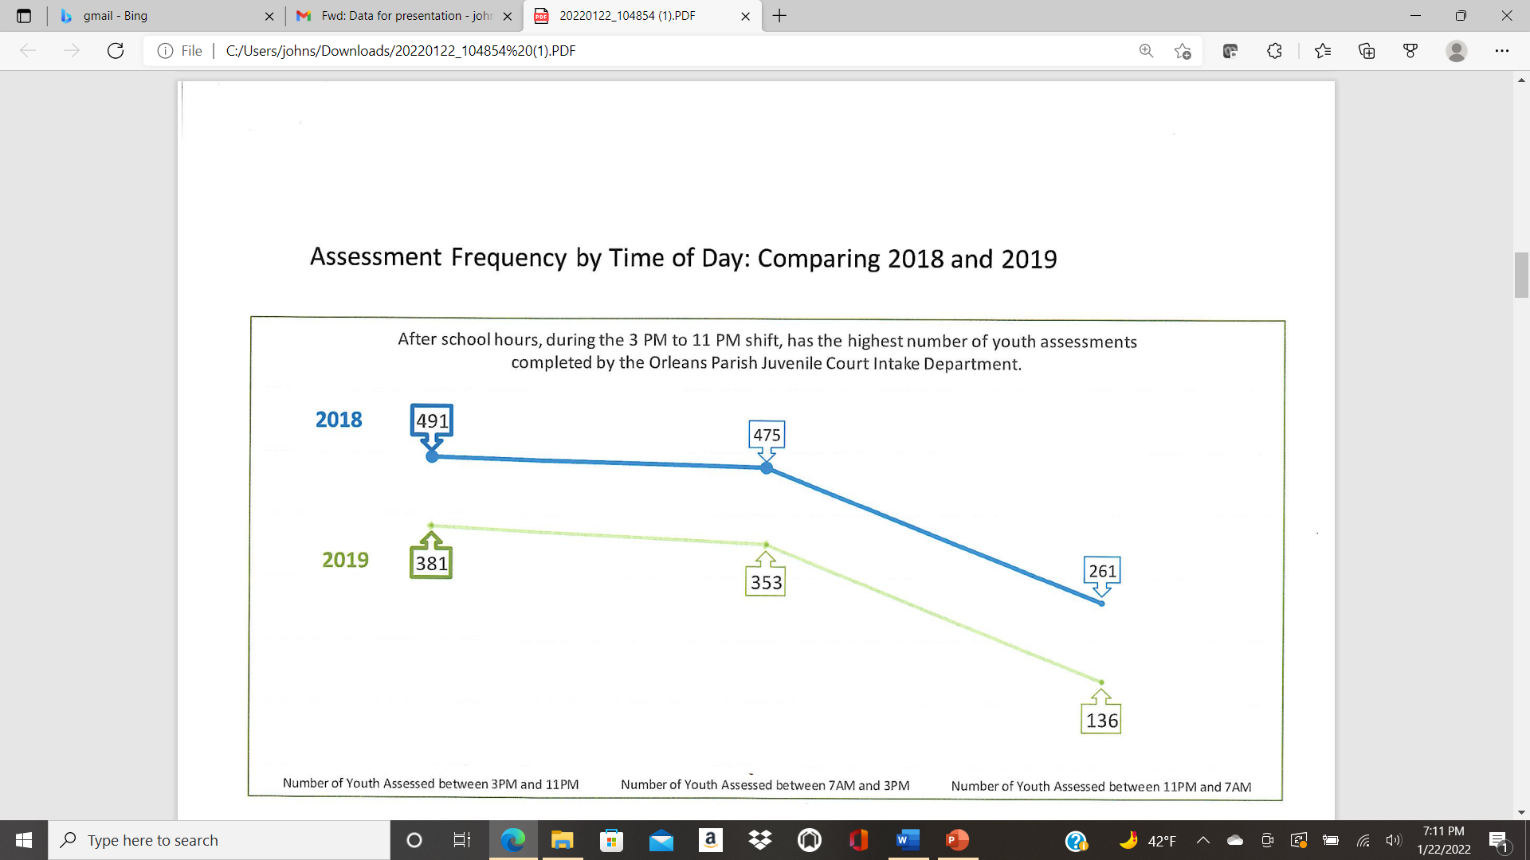

Slide 7
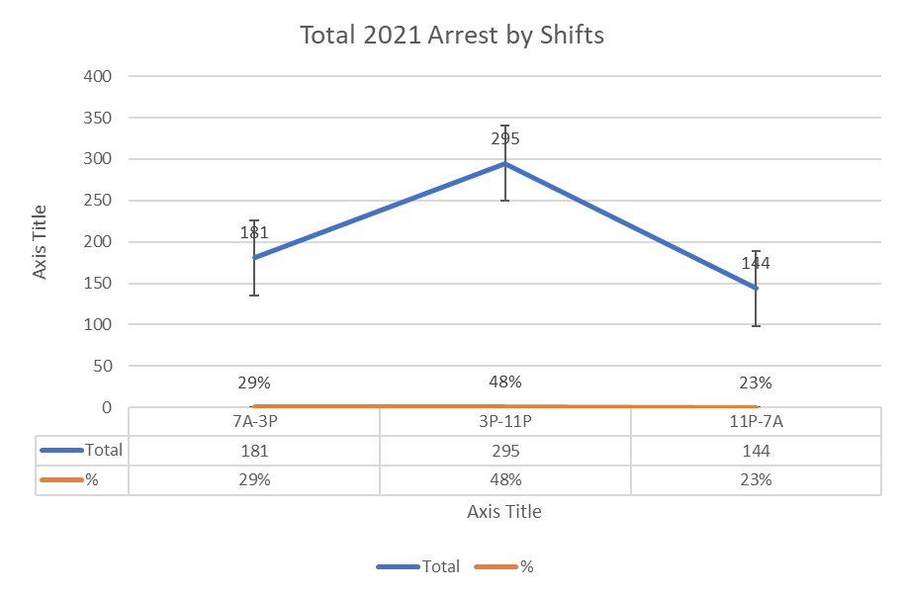

Slide 9
Dispositions/Outcomes
Transferred to Criminal District Court - 13
Pending Continued Custody Hearing - 8
Pending Adjudication Hearing - 3
Pending Disposition - 2
Found Not Delinquent - 1

Slide 10
ORLEANS PARISH JUVENILE COURT
2021 RELEASED AND DETAINED YOUTHS
Race | Sex | Intake Decision | # | Total | %
Black | Female | Courtesy Hold | 3
Black | Male | Courtesy Hold | 10
Black | Female | Courtesy Hold (Released) | 2 | 15 | 2.60%
Black | Female | Referred to Program | 20
Black | Male | Referred to Program | 38
Hispanic | Male | Referred to Program | 2 | 60 | 10.38%
Black | Male | Released JPSO | 1
Black | Female | Released JPSO | 4
Black | Female | Released DCFS | 1
White | Female | Released JPSO | 1 | 7 | 1.211%
Black | Female | Released | 28
Black | Male | Released | 34
White | Female | Released | 2
White | Male | Released | 4 | 68 | 11.76%
Black | Female | Detained | 41
Black | Male | Detained | 383
Hispanic | Male | Detained | 3
White | Male | Detained | 1 | 428 | 74.05%
 |  | Total | 578 |  | 100.00%

Slide 11
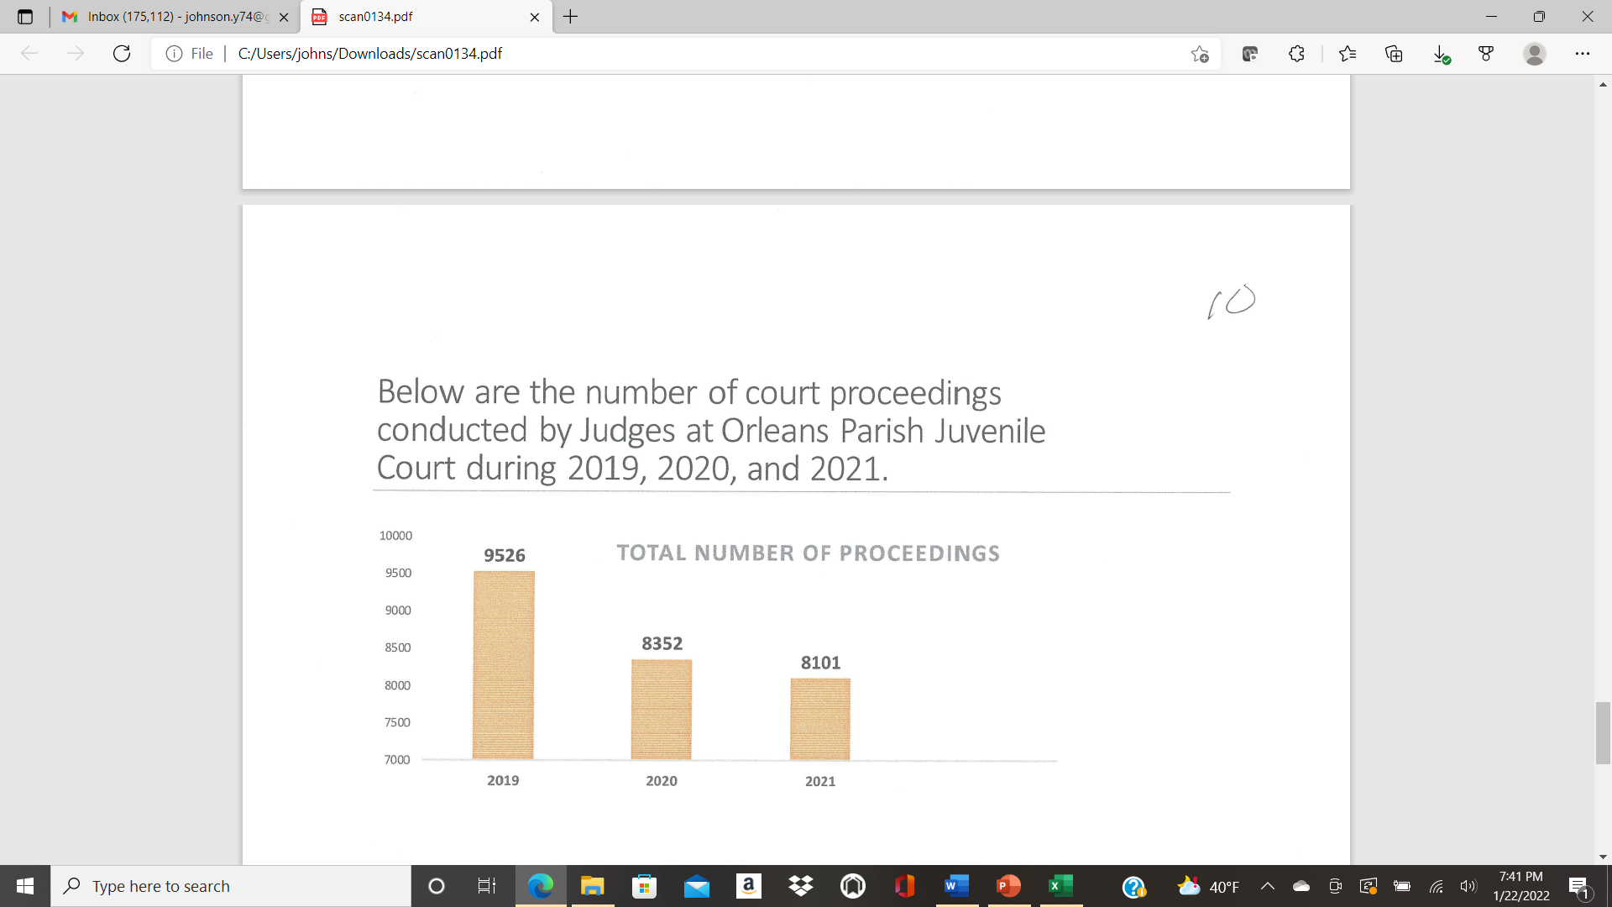

Slide 14

Challenges Faced by the Court
Inability to make meaningful assessments of need and risks at case initiation.
Inability to adequately supervise youth both pre-adjudication and post-adjudication.
Inadequate community-based resources to support court-involved youth and families.

Slide 15
Suggestions from the bench
Develop interventions that target High Risk Youth.
Supplement probation services (currently provided by Louisiana Office of Juvenile Justice) preferably within the community.
Provide method for needs-based assessment at initiation of case.
Divert Low-Risk Youth away from conventional judicial proceedings.

