Slide 1
Neighborhood Leaders Roundtable Department of Sanitation

Slide 2
Department Mission & Vision
Mission Statement
To provide solid waste services to the citizens of New Orleans through the collection, disposal and recycling of discarded material in a manner that is safe, efficient, environmentally sound and cost effective; to enforce State, Federal and local laws and regulations to eliminate illegal dumping and littering; and to provide public education on litter abatement, recycling and other solid waste issues.
Vision Statement
To provide sustainable and cost effective waste collection disposal and recycling options that will result in a cleaner and safer New Orleans.

Slide 3
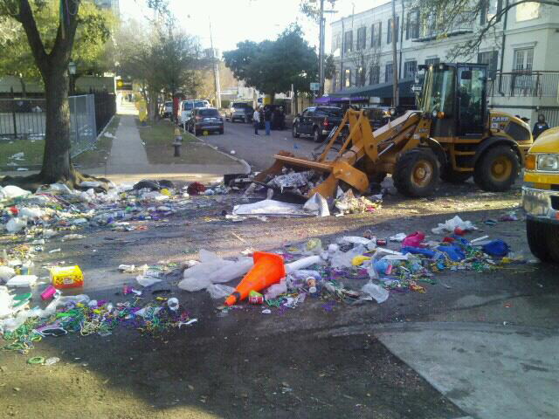
Special Event Clean-Up
New Year’s
Mardi Gras
St. Patrick’s/St. Joseph’s Day
French Quarter Festival
Jazz and Heritage Festival
Essence Festival
Satchmo Festival
Bayou Classic
Halloween

Slide 4
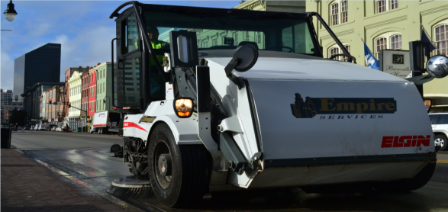
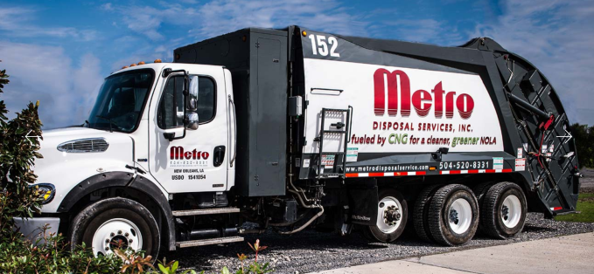
Oversight of Contractors
Empire Services
Metro Disposal
Richard’s Disposal
Gentilly Landfill
Temporary Services for Labor and Equipment
Supplemental Interstate Sweeping, Mowing and Litter Removal

Slide 5
Other Responsibilities
Mechanical Street Sweeping and Flushing on Major Thoroughfares and Bridges
Clearing Illegal Dumping Sites
Working with Community Service Programs
Delivering and Repairing Recycling Carts and Bins
Purchasing, Delivering, Maintaining and Emptying Public Litter Cans (246 Solar and 1,176 Wrought Iron units)
Regulatory Reports and Permits
Removing Bandit Signs
Enforcement of the City Ordinances
Reviewing Permits for Sanitation Plans
Procurement and Contracting

Slide 6
RECYCLING
CURBSIDE
ONCE A WEEK FOR ELIGIBLE PROPERTIES
ITEMS ACCEPTED:
NEWSPAPERS, JUNK MAIL, OFFICE PAPER, MAGAZINES, CATALOGS, PHONE BOOKS, PLASTIC (#1 - #7), SMALL METALS, CARDBOARD, BOXBOARD, WAXBOARD
MONTHLY DROP OFF - 2829 ELYSIAN FIELDS
ITEMS ACCEPTED (in addition to the above)
Glass, E-Waste, Mardi Gras Beads, light bulbs (incandescent/fluorescent), Microwave ovens, Batteries (AA,AAA,AAAA,C,D, 6 & 9 volt), tires

Slide 7
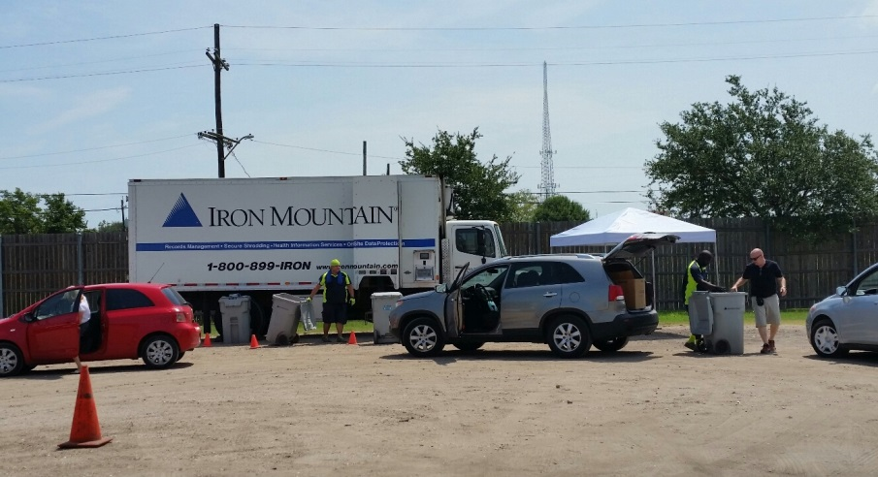
Recycling Drop-Off Schedule
SECOND SATURDAY OF EACH MONTH
2829 ELYSIAN FIELDS AVENUE
8:00 a.m. - 1:00 p.m.
For More Information or to Register for FREE Curbside Recycling: Call: 311
REMAINING 2016 SCHEDULE
May 13, 2017 | Household Hazardous Materials Collection Day
June 10, 2017
July 8, 2017 | Shred Day
August 12, 2017
September 9, 2017
October 14, 2017 | Shred Day
November 11, 2017
December 9, 2017 | Shred Day

Slide 8
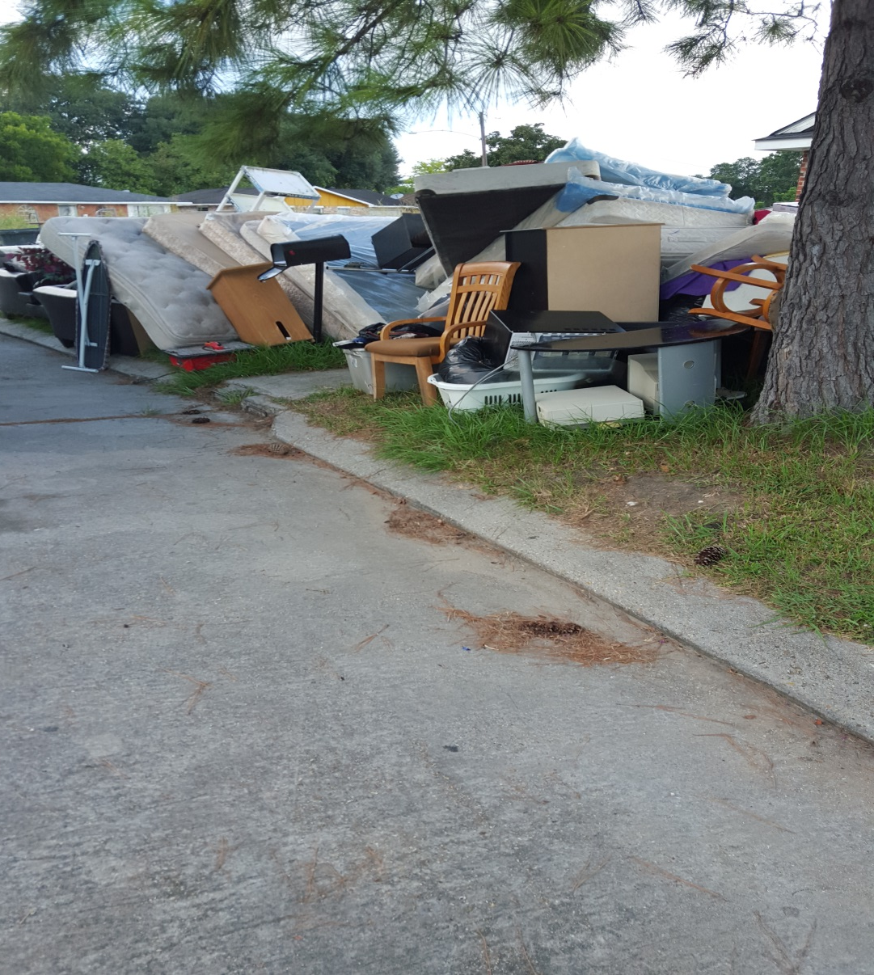
Equipment Maintenance and Training
Street Sweepers
Flushers
Front End Loaders
Skid Steers
Garbage Trucks
Tractor Trailers
Dump Trucks
Yard Spotters
Tractor Trucks
Telehandler

Slide 9
Performance Measures
Performance Summary
Measure | 2016 Year-End
Number of miles of streets mechanically swept | 18,521
Number of illegal dumping sites cleared | 1,951
Percent of 311 illegal dumping service requests completed within 30 days | 80%
Households registered for recycling | 56,532
Amount of landfill cost savings resulting from recycling | $223,077
Amount of landfill disposal costs | $5,494,343
Amount of special event costs | $1,409,128
Number of tons of recyclable material collected | 7,102

Slide 10
HOW YOU CAN HELP
Do not litter and do not sweep, blow or pour items into storm drains (contents flow to the lake)
Do not place signs on public ROWs (neutral grounds, posts)
Properly contain trash in carts & cut trees: bundle-max 4’ long
Remove carts from the curb after collection
Call 311:
To schedule a bulky waste pick up
To register for curbside recycling & receive a cart
To report illegal dumping or litter
Call a private hauler: construction items or +10 yards debris
Property owners are responsible for removing litter, dumping, and keeping grass below 18” up to 1.5 feet from the curb

Slide 11
HELPFUL INFORMATION
PROPERTIES ELIGIBLE FOR CITY COLLECTION
Four units or less under one roof
Cannot be a hotel, restaurant or a bar
Cannot exceed the volume of a regular collection
BULKY WASTE – (Eligible Residential Properties)
Picked up on the second collection of the week – or call 311 to schedule
Furniture, mattresses, appliances, up to 4 tires, tree limbs or carpet (cut in 4’ lengths) -10 yd. limit
PERMANENT DUMPSTERS must be screened

Slide 12
Continued partnerships with agencies & neighborhood groups to support recycling & clean-up efforts

